Slide 1



Buffer Overflow Attacks

Slide 2

What is a Buffer Overflow Attack
Buffers are memory storage regions that temporarily hold data while it is being transferred from one location to another. A buffer overflow (or buffer overrun) occurs when the volume of data exceeds the storage capacity of the memory buffer. As a result, the program attempting to write the data to the buffer overwrites adjacent memory locations.
For example, a buffer for log-in credentials may be designed to expect username and password inputs of 8 bytes, so if a transaction involves an input of 10 bytes (that is, 2 bytes more than expected), the program may write the excess data past the buffer boundary.

Slide 3

Buffer overflows can affect all types of software. They typically result from malformed inputs or failure to allocate enough space for the buffer. If the transaction overwrites executable code, it can cause the program to behave unpredictably and generate incorrect results, memory access errors, or crashes.

Slide 4
Types of Buffer Overflow Attacks
Stack-based buffer overflows are more common, and leverage stack memory that only exists during the execution time of a function.
Heap-based attacks are harder to carry out and involve flooding the memory space allocated for a program beyond memory used for current runtime operations.

Slide 5
What Programming Languages are More Vulnerable?
C and C++ are two languages that are highly susceptible to buffer overflow attacks, as they don’t have built-in safeguards against overwriting or accessing data in their memory. Mac OSX, Windows, and Linux all use code written in C and C++.
Languages such as PERL, Java, JavaScript, and C# use built-in safety mechanisms that minimize the likelihood of buffer overflow.

Slide 6
How to Prevent Buffer Overflows
Developers can protect against buffer overflow vulnerabilities via security measures in their code, or by using languages that offer built-in protection. In addition, modern operating systems have runtime protection. Three common protections are:
Address space randomization (ASLR)-randomly moves around the address space locations of data regions. Typically, buffer overflow attacks need to know the locality of executable code, and randomizing address spaces makes this virtually impossible.
Data execution prevention-flags certain areas of memory as non-executable or executable, which stops an attack from running code in a non-executable region.

Slide 7
Structured exception handler overwrite protection (SEHOP)-helps stop malicious code from attacking Structured Exception Handling (SEH), a built-in system for managing hardware and software exceptions. It thus prevents an attacker from being able to make use of the SEH overwrite exploitation technique. At a functional level, an SEH overwrite is achieved using a stack-based buffer overflow to overwrite an exception registration record, stored on a thread’s stack.
Security measures in code and operating system protection are not enough. When an organization discovers a buffer overflow vulnerability, it must react quickly to patch the affected software and make sure that users of the software can access the patch.

Slide 8
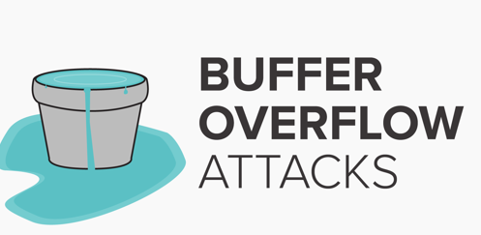
Thanks For Watching!

